Slide 1


Python For Data Engineers
mintesnot

Slide 2
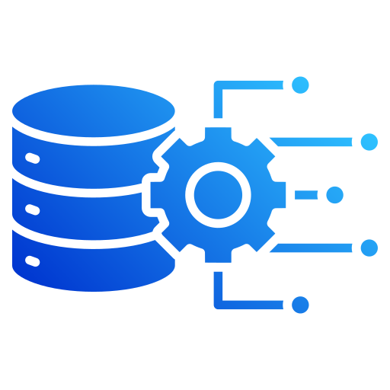
What is Python?
Responsibilities of A Data Engineer
Data Engineer Vs. Data Analyst Vs. Data Scientist
Modern Data Platform
Data Sources
Data Lake
Data Warehouse
Data Engineering Skills
Cloud Data Engineering

Slide 3
What is Python?
Python is a high-level, interpreted, and general-purpose programming language by Guido van Rossum in 1991.
Why Python?
✅ Easy to learn ✅ Easy to read ✅ Large community support ✅ Thousands of libraries available ✅ Cross-platform (Windows, Linux, macOS)
Popular Uses
Web Development
Data Analysis, Data Engineering & Data Scientist
Machine Learning
Artificial Intelligence
Automation
Cybersecurity
Game Development

Slide 4
Why Python for Data Engineering?
Python is one of the most popular languages for Data Engineering because:
✅ Easy to learn
✅ Large ecosystem
✅ Powerful libraries
✅ Excellent community support
✅ Works with databases, APIs, cloud platforms, and big data tools
Common Uses
Data extraction
Data cleaning
Automation
ETL pipelines
Data validation
Data integration

Slide 5
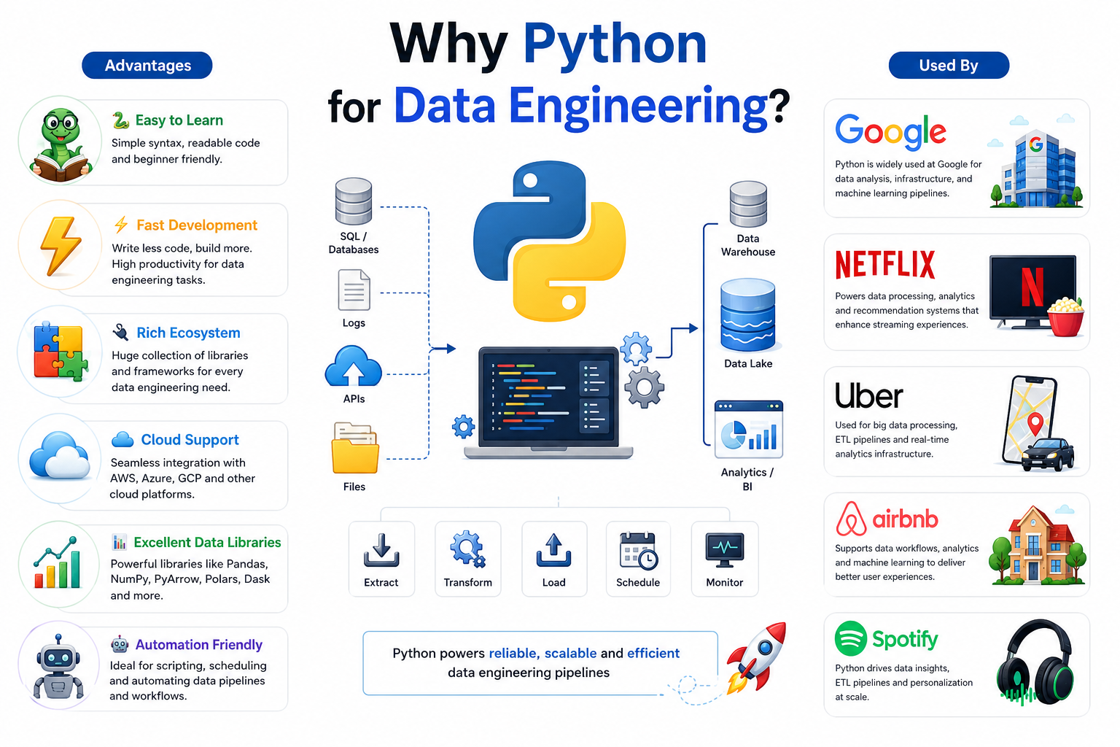
Advantages
🐍 Easy to Learn
⚡ Fast Development
🔌 Rich Ecosystem
☁️ Cloud Support
📊 Excellent Data Libraries
🤖 Automation Friendly
Used By
Google
Netflix
Uber
Airbnb
Spotify

Slide 6
Popular Python Libraries for Data Engineers
Library | Purpose
Pandas | Data analysis and manipulation
NumPy | Numerical computing
Requests | API communication
Requests | API communication
JSON | Handle JSON data
CSV | Handle CSV files
SQLAlchemy | Database connections
PySpark | Big Data processing
OpenPyXL | Excel automation
Matplotlib | Visualization

Slide 7
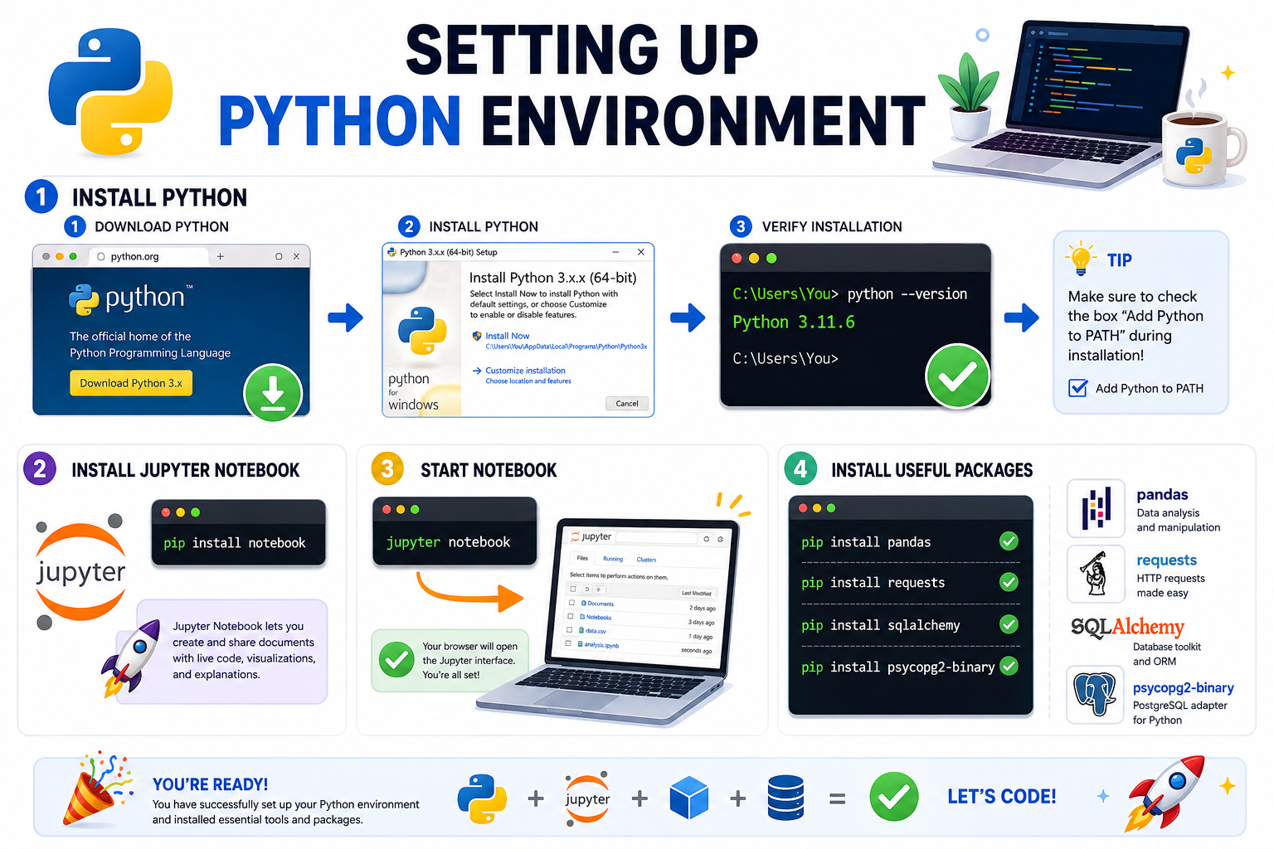
Setting Up Python Environment
Install Python
Download Python
Install Python
Verify installation
python --version
Install Jupyter Notebook
pip install notebook
Start Notebook
jupyter notebook
Install Useful Packages
pip install pandas pip install requests pip install sqlalchemy pip install psycopg2-binary

Slide 8

What is Jupyter Notebook?
Jupyter Notebook is an interactive environment where you can:
Write code
Run code step-by-step
Visualize results
Document your work
Share notebooks
Benefits
✅ Beginner friendly
✅ Interactive learning
✅ Great for experimentation
✅ Widely used by Data Engineers and Data Scientists

Slide 9
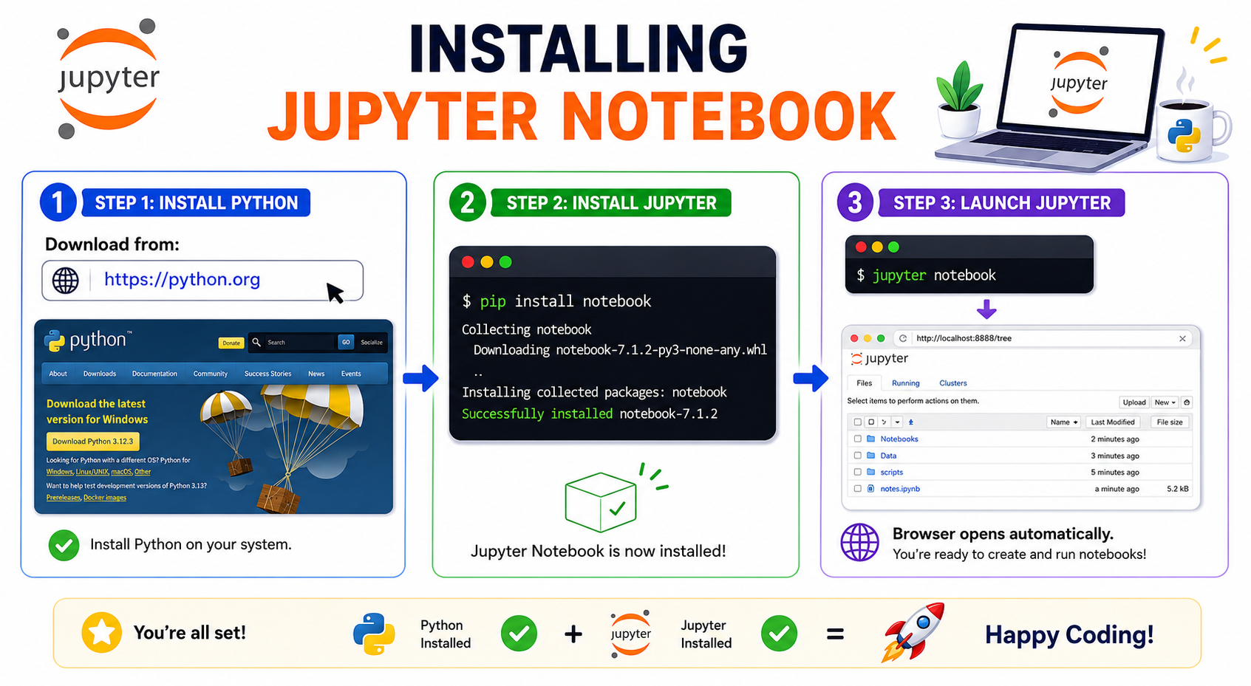
Installing Jupyter Notebook
Step 1 - Install Python
Download from:
https://python.org
Step 2 - Install Jupyter
pip install notebook
Step 3 - Launch Jupyter
jupyter notebook
Browser opens automatically.

Slide 10
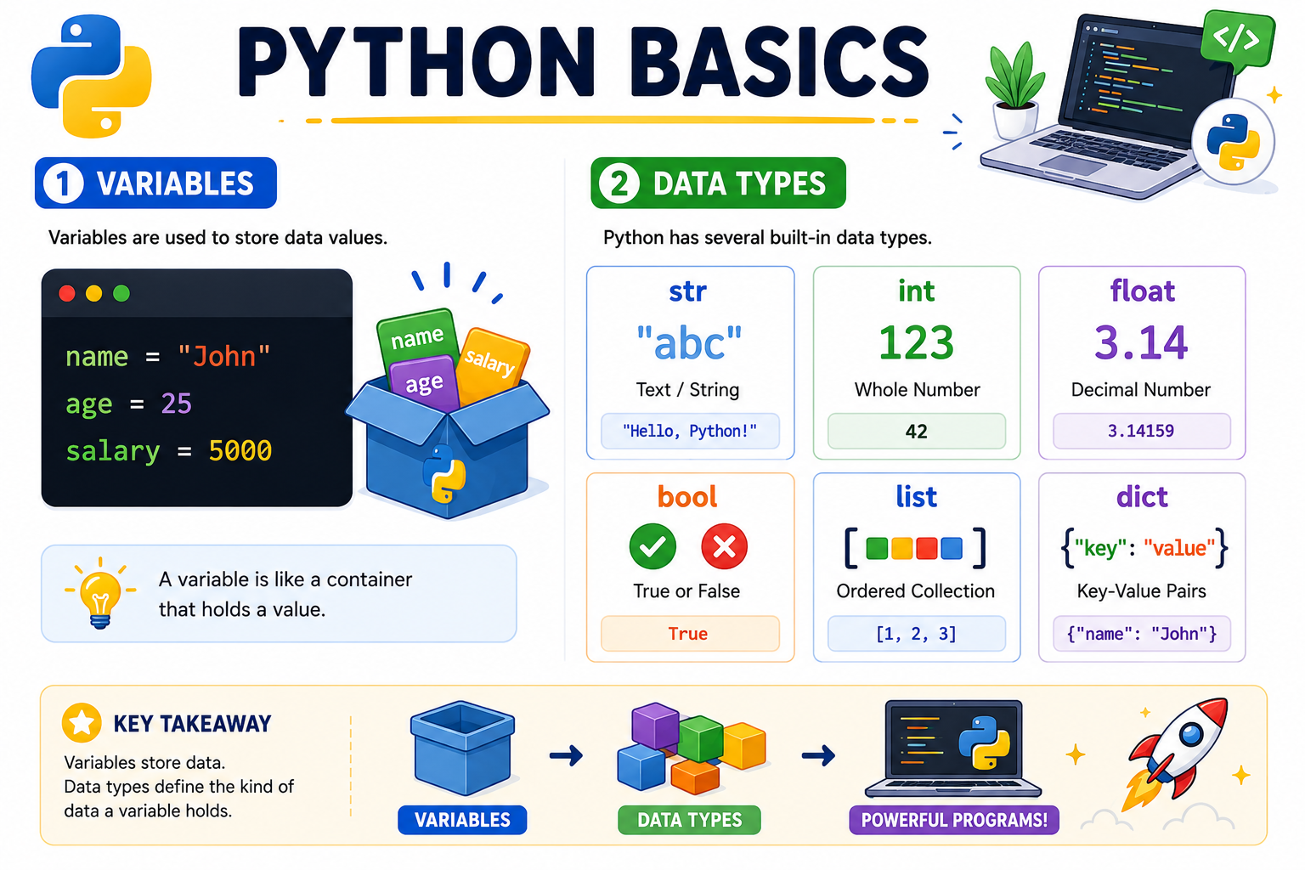

Python Basics
Variables
name = "John" age = 25 salary = 5000
Data Types
str int float bool list dict

Slide 11
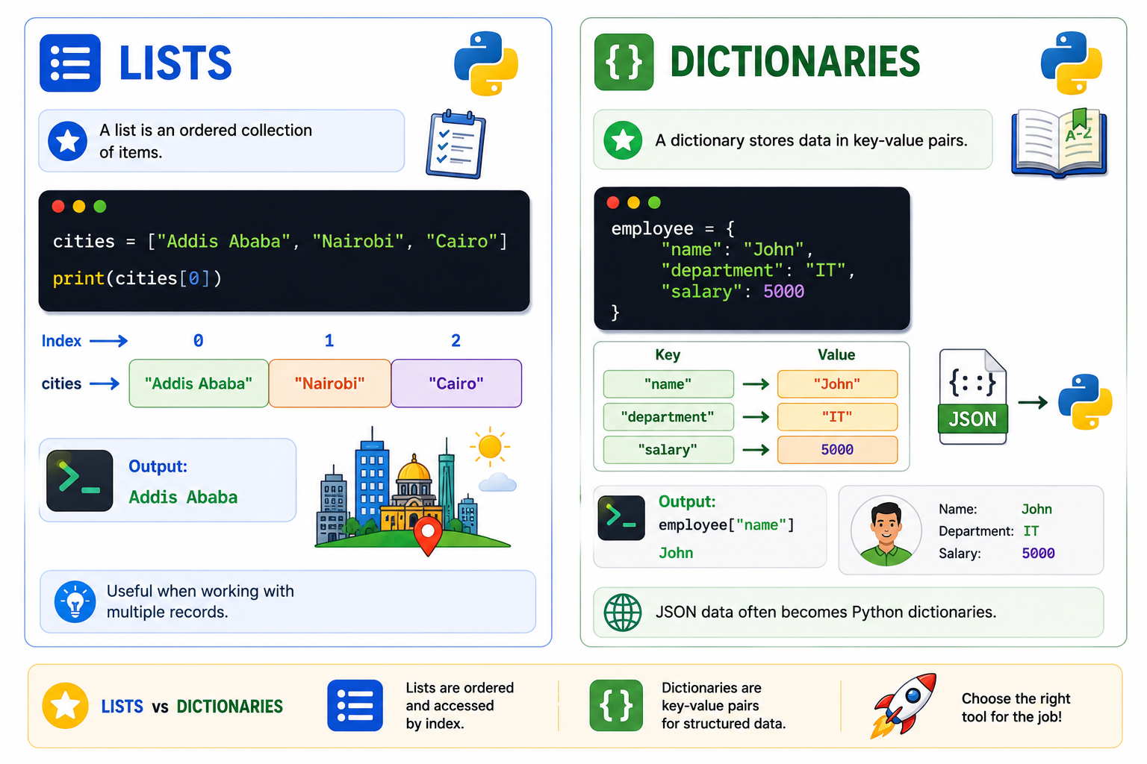
Lists & Dictionaries
Lists
Useful when working with multiple records.
cities = ["Addis Ababa", "Nairobi", "Cairo"] print(cities[0])
Output: Addis Ababa
Dictionaries
JSON data often becomes Python dictionaries.
employee = { "name": "John", "department": "IT", "salary": 5000 }
Output: employee["name"] - John

Slide 12
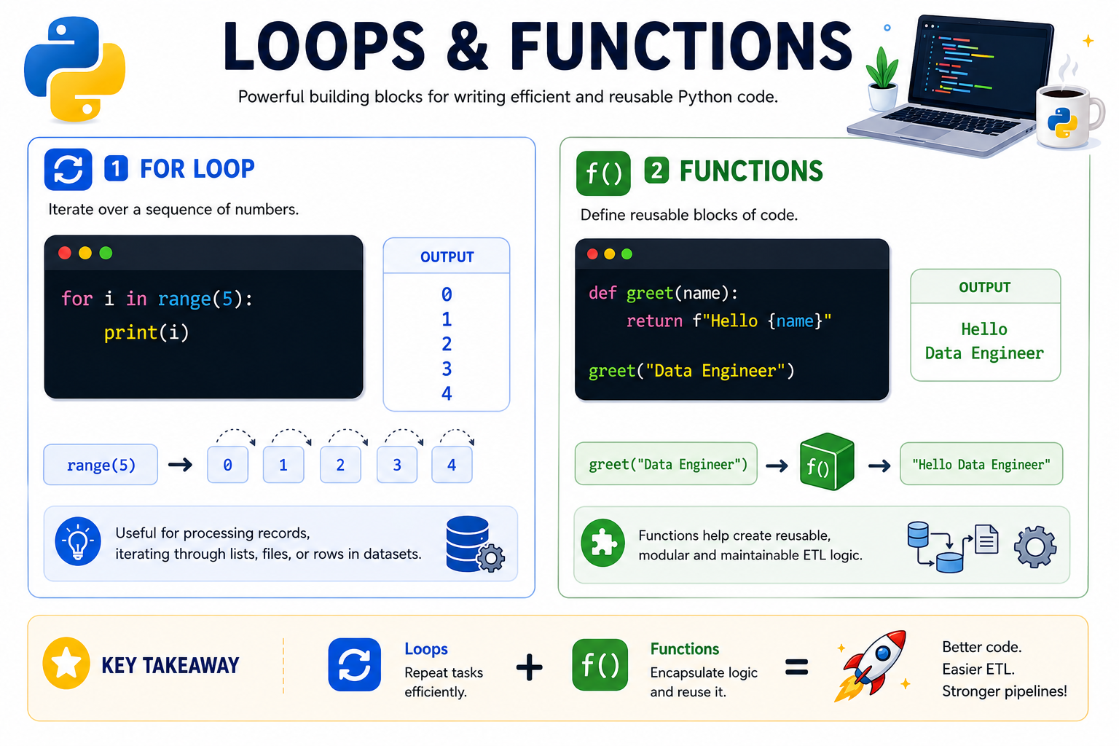
Loops & Functions
Loops
Useful for processing records.
For Loop
for i in range(5): print(i)
Output:
0 1 2 3 4
Functions
Functions help create reusable ETL logic.
def greet(name): return f"Hello {name}" greet("Data Engineer")
Output:
Hello Data Engineer

Slide 13
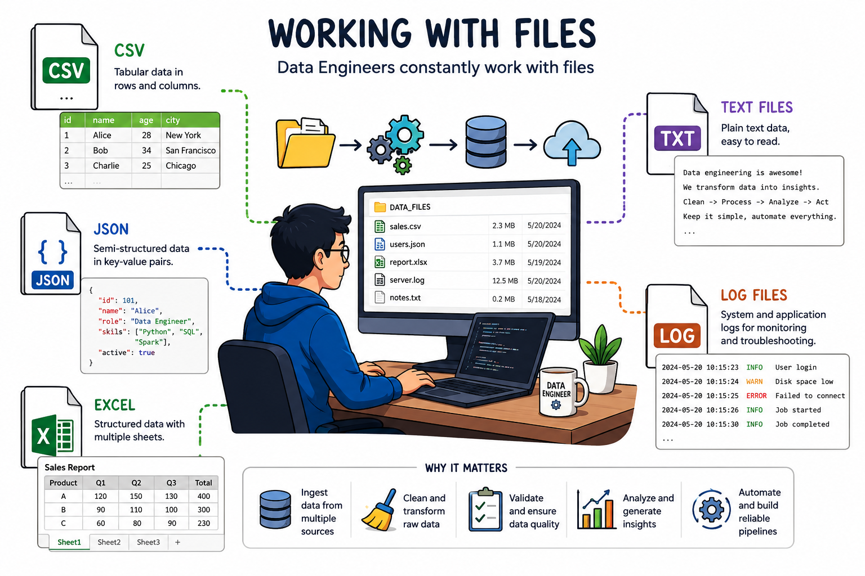
Working With Files
Data Engineers constantly work with files:
📄 CSV
📄 JSON
📄 Excel
📄 Text Files
📄 Log Files

Slide 14
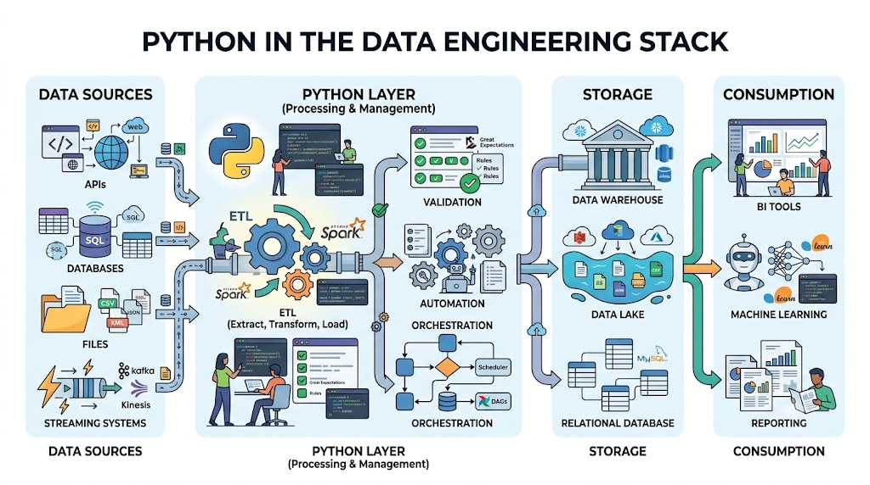

Slide 15

Key Takeaways
Python is the most important language for Data Engineers.
Jupyter Notebook is ideal for learning and prototyping.
CSV and JSON are essential data formats.
APIs are major data sources.
ETL is the foundation of Data Engineering.
Automation increases efficiency.

